Slide 1
Azure ML Services

Slide 2
Process:
Creation of workspace
Creation of Azure notebook vm which will have connection to azure ml workspace
Creation of Environment
Uploading data to cloud( to default data store)
Creation of training script which also includes pre-processing of data set to fit the model and mounting default data store
Creation of compute resource
Creation of estimator and submission of job to the cluster
Monitor the remote run and display results
Registering the model
Testing the model
Deploy as a web service and Testing

Slide 3
Details:
Work space name: capstone_ws
Experiment name: Env-LoanApproval-AzureNB
Model name: sklearn_LoanApproval
Pkl file: sklearn_loanapproval_model.pkl
Model: LogisticRegression
I have attached screenshots in next slides please review them

Slide 4
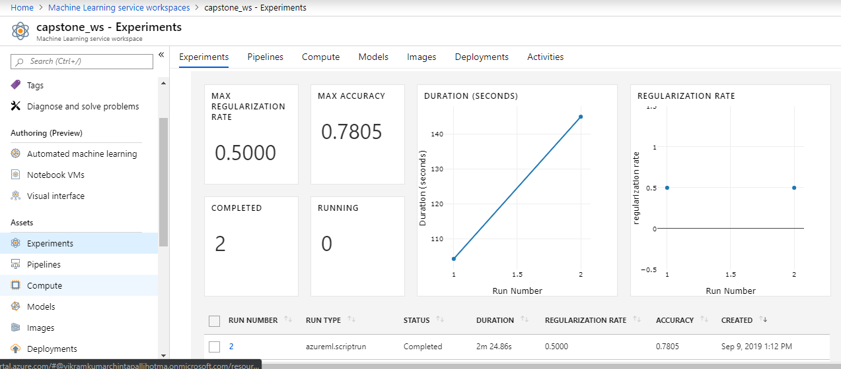
Work space and experiment

Slide 5
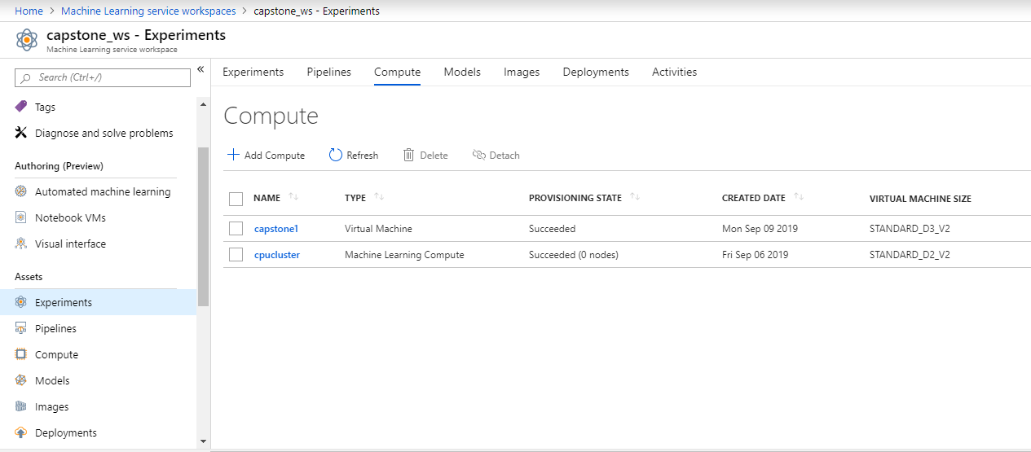
Compute

Slide 6
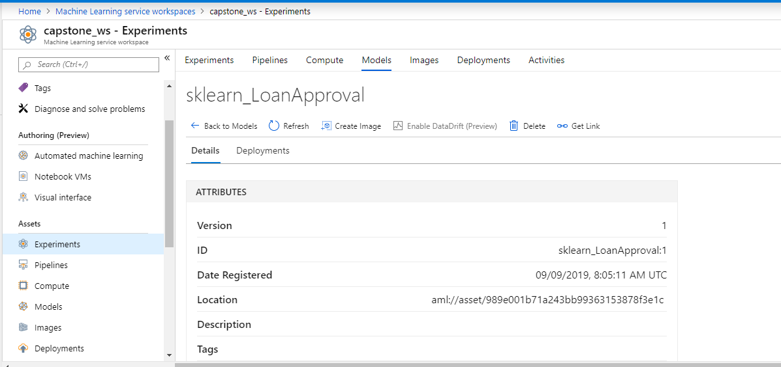
Models

Slide 7
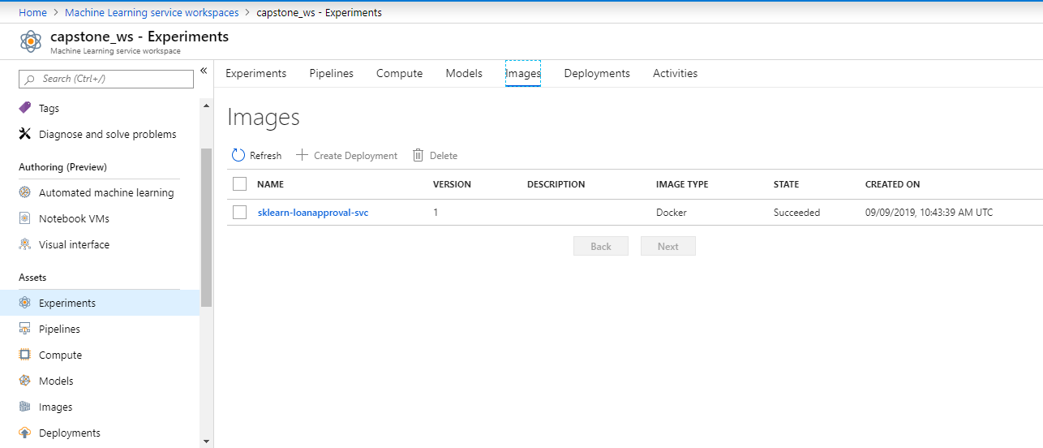
Docker Image

Slide 8
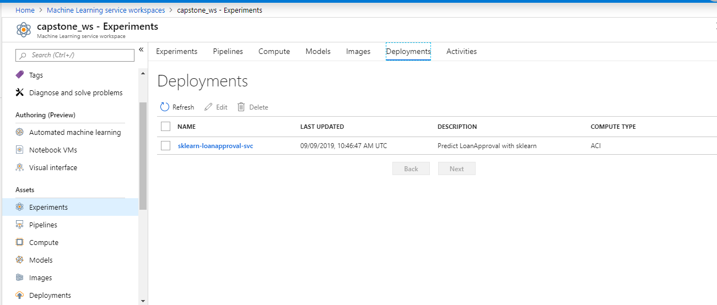
Deployments

